Slide 1

PMC COMPETENCY PROGRAM

Slide 2
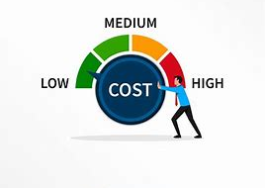
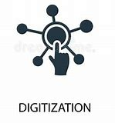
Workforce challenges
Key Trends
Skill Shortage
Increased Work Hours
Lack of specialized skills
OPTIMIZATION
LOSS OF PRODUCTIVITY

Slide 3



TRADITIONAL TRAINING MODEL CHALLENGES
Generalized training to meet all employee profiles
Difficult to measure the results
Address Immediate Needs

Slide 4

COMPETENCY PROGRAM
Enables Continuous Learning
Develops Collaboration
Agile Learning
Goal Oriented
Assessment
SKILL DEVELOPMENT

Slide 5
COMPETENCY PROGRAM ELEMENTS
Step 1: Workforce Skills Assessment
How many Employees
Current Skill Level
Step 2: Improve and Measure
Train and Certify Employees
Step 3: Post Training Support
Access to Trainers & FSEs
Update Competency Matrix
Desired KPIs
Assess effectiveness
Goal Oriented & Measurable

Slide 6
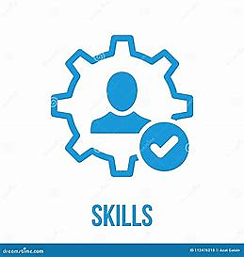
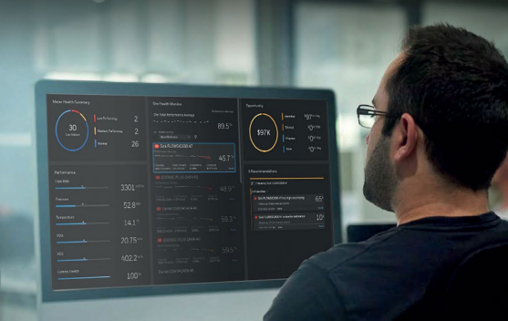

Workforce SKILLS ASSESMENT
Step 1: Workforce Skills Assessment
Skills identification and development is core element to competency program
Role
Perform a Job
Skill varies for each persona

Slide 7
Workforce skills assessment
Step 1: Workforce Skills Assessment
Example: Employee Roles in Tank Gauging System
Maintenance Engineer
Operator
Key Skills
Key Skills
Startup configuration
Routine Preventive Maintenance
Troubleshooting.
Operational Startup/Setup
Loading and Unloading
Advance Batch Movement Planning.

Slide 8
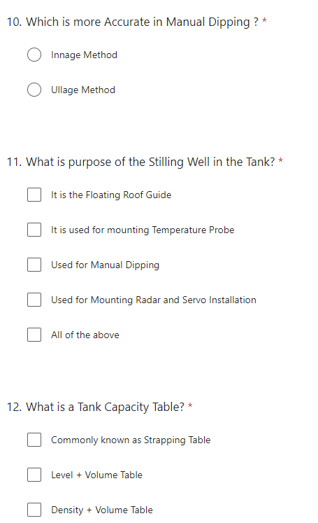
Workforce SKILLS ASSESMENT
Step 1: Workforce Skills Assessment
Know your current skill levels
Skill Score and Mapping
Current Skill Level
Online -Questionnaire
Skill Assessment Framework

Slide 9
IMPROVE SKILLS
Step 2: Improve and Measure
Introduce Learning Path
Training Modules for each level
ENRAF Service Tools Software for Backup, Maintenance, Diagnostics, Troubleshooting, and related Firmware upgrades. Level 3
Level1
Level2
Level3
ENRAF Tank Gauging Field Instruments Maintenance
ENRAF Tank Gauging Field Instruments diagnostics
and troubleshooting techniques.
ENRAF Service Tools Software
Precise Level and Inventory Fundamentals
ENRAF TGS Basics and Principle
ENRAF TGS Installation, Startup and
Configuration
ENRAF TGS RPM 1st Level
Maintenance Engineer (Field Instruments) - TGS

Slide 10
IMPROVE & measure
Step 2: Improve and Measure
Skill Mapping & Review
Current Skill Level
Online -Questionnaire
Update Competency Matrix

Slide 11




ACCESS TO EXPERTS
Step 3: Post Training Support
Remote Support
Meet in Person
Email
Various modes of support offered

Slide 12


COMPETENCY PROGRAM
Learn, Implement, Assess & Connect!
Level 1, 2,3
Training
Implement the learning
Assessment
Connect with Expert
Continuous Learning!

Slide 13
WHY HONEYWELL?
Program shall cover all Honeywell products (PMC)
Time bound and measurable - Outcome based training
Learning platform is Agile
Experienced field representatives shall be the trainers
Provides effective/dynamic practical session with the involvement of field service team as trainer
Flexible post training support options
Honeywell Framework is flexible to Build your own Training Program
Invest on Competency, Increase the Productivity

Slide 14
THANK YOU
WE DELIVER INCREASINGLY ACCURATE, PREDICTABLE, AND EFFICIENT BUSINESS OUTCOMES FOR OUR CUSTOMERS ACROSS SAFETY, SUSTAINABILITY, AND ASSET PERFORMANCE

